Slide 1
CIVIL ENGINEERING
“The road to success is always under construction” Get it right….CIVIL ENGINEERS

Slide 2
WHAT DOES IT DO?
Civil engineering is the broadest of the engineering fields. Civil engineering focuses on the infrastructure of the world which include Water works, Sewers, Dams, Power Plants, Transmission Towers/Lines, Railroads, Highways, Bridges, Tunnels, Irrigation Canals, River Navigation, Shipping Canals, Traffic Control, Mass Transit, Airport Runways, Terminals, Industrial Plant Buildings, Skyscrapers, etc.

Slide 3
BRANCHES OF CIVIL ENGINEERING
CONSTRUCTION ENGINEERING
IRRIGATION ENGINEERING
TRANSPORTATION ENGINEERING
SOILS AND FOUNDATIONS ENGINEERING
HYDRAULIC ENGINEERING
COASTAL AND OCEAN ENGINEERING

Slide 4
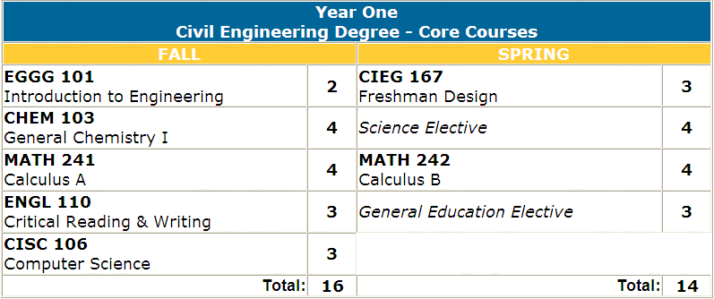
BACKGROUND KNOWLEDGE

Slide 5
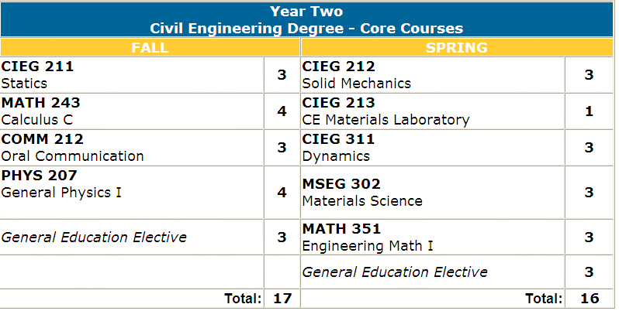

Slide 6
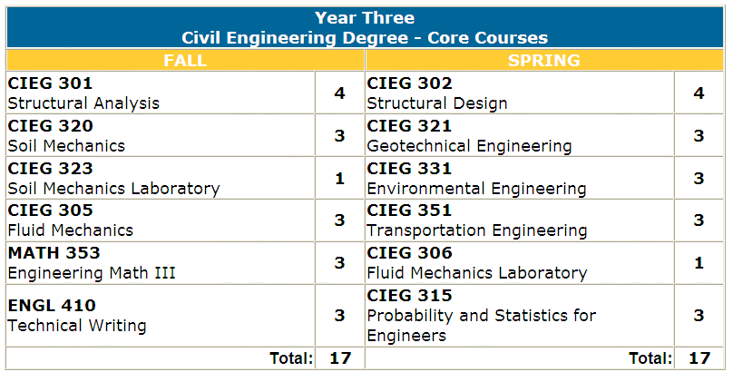

Slide 7
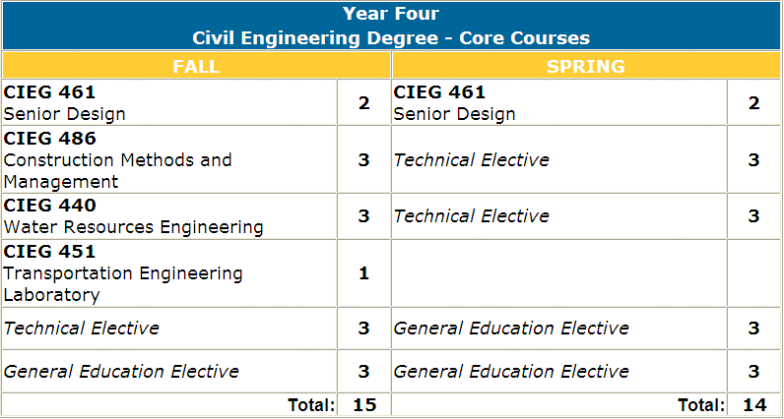

Slide 8
UNIVERSITIES
Civil Engineering Universities
The following list contains the universities which offer civil engineering in USA If you feel like adding more or there is any correction then mail me at
admin@engineeringcivil.com
Alabama A&M University Arizona State University Arkansas State University Auburn University Boise State University Bradley University Brigham Young University Brown University California Institute of Technology California Polytechnic State University - San Luis Obispo California State Polytechnic University - Pomona California State University - Chico California State University - Fresno California State University - Fullerton California State University - Long Beach California State University - Los Angeles California State University - Sacramento Calvin College Carnegie Mellon University Carroll College Case Western Reserve University Catholic University of America, The Christian Brothers University

Slide 9
City College of New York, The Clarkson University Clemson University Cleveland State University College of New Jersey, The Colorado School of Mines Colorado State University Columbia University Cooper Union for the Advancement of Science & Art Cornell University Dakota State University Dordt College Drexel University Duke University Florida Atlantic University Florida Institute of Technology Florida International University Florida State University George Mason University George Washington University, The Georgia Institute of Technology Howard University Idaho State University Illinois Institute of Technology Indiana Institute of Technology Iowa State University Johns Hopkins University Kansas State University Lafayette College La

Slide 10
HOMEWORK FOR SUNDAY (MIDNIGHT)
FIND OUT INFORMATION ABOUT THE BRANCHES OF CIVIL ENGINEERING AND MAKE A COMPARISON CHART.
CHOOSE ONE OF THE UNIVERSITIES THAT HAS CIVIL ENGINEERING AND CHECK OUT THE CURRICULUM. COPY IT TO YOUR ASSIGNMENT.

