Slide 1
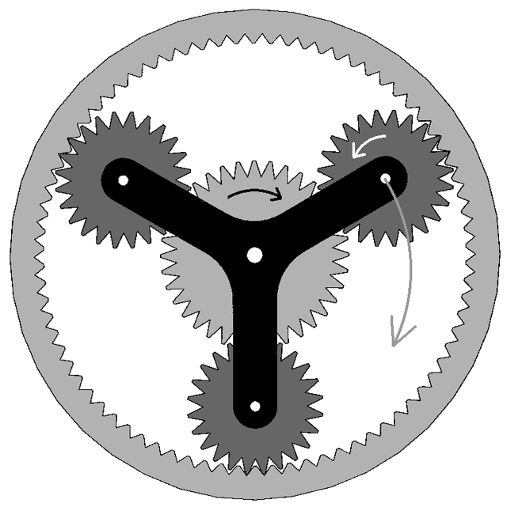
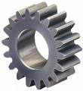
MECHANICAL ENGINEERING

Slide 2
CARRER OVERVIEW
The term mechanical engineering refers not only to specific profession, but also to a spectrum of occupations and challenges that lie withing the broad field of engineering. Mechanical engineering comprises a wide range of activities, including research, development, design, testing, manufacturing and production, operations and maintance, and marketing and sales. The many areas withing the scope of mechanical engineering and automation, and the control of engineering systems, subsystems and their components.

Slide 3
TWO OPTIONS
MECHANICAL ENGINEERING
MECHANICAL ENGINEERING TECHNOLOGY.

Slide 4
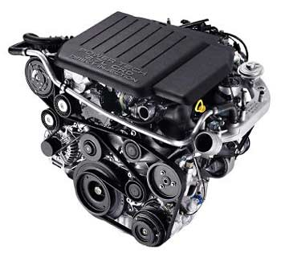
ROLES
Mechanical engineering is a diverse subject that derives its breadth from the need to design and manufacture everything from small individual parts and devices (e.g., microscale sensors and inkjet printer nozzles) to large systems (e.g., spacecraft and machine tools). The role of a mechanical engineer is to take a product from an idea to the marketplace. In order to accomplish this, a broad range of skills are needed. The mechanical engineer needs to acquire particular skills and knowledge. He/she needs to understand the forces and the thermal environment that a product, its parts, or its subsystems will encounter; to design them for functionality, aesthetics, and the ability to withstand the forces and the thermal environment they will be subjected to; and to determine the best way to manufacture them and ensure they will operate without failure. Perhaps the one skill that is the mechanical engineer’s exclusive domain is the ability to analyze and design objects and systems with motion.

Slide 5
MAKE LIFE EASIER
To put it simply, mechanical engineering deals with anything that moves, including the human body, a very complex machine. Mechanical engineers learn about materials, solid and fluid mechanics, thermodynamics, heat transfer, control, instrumentation, design, and manufacturing to understand mechanical systems. Specialized mechanical engineering subjects include biomechanics, cartilage-tissue engineering, energy conversion, laser-assisted materials processing, combustion, MEMS, microfluidic devices, fracture mechanics, nanomechanics, mechanisms, micropower generation, tribology (friction and wear), and vibrations. The American Society of Mechanical Engineers (ASME) currently lists 36 technical divisions, from advanced energy systems and aerospace engineering to solid-waste engineering and textile engineering.

Slide 6
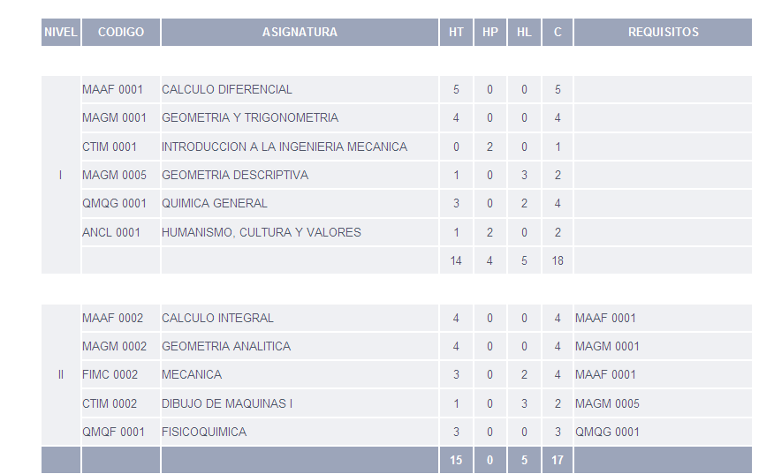
STUDY PLAN

Slide 7
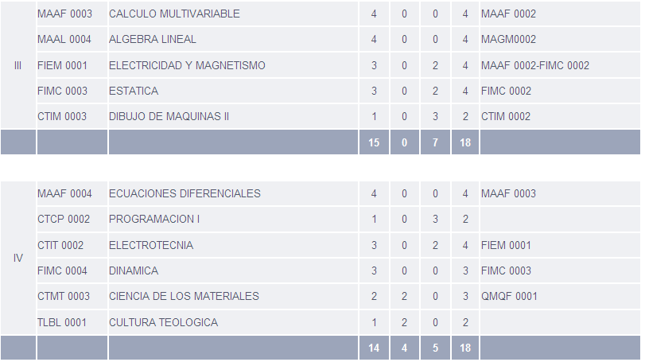

Slide 8
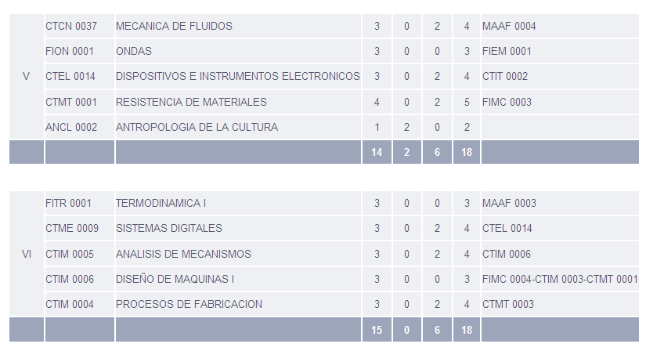

Slide 9
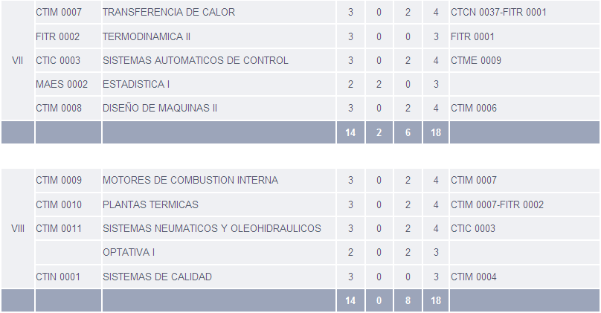

Slide 10
